Slide 1

DEV SANSKRITI VISHWAVIDYALAYA
INTRODUCTION TO
E COMMERCE
PRANAV AADITYA

Slide 2

ACKNOWLEDGEMENT I would like to express my sincere gratitude to all those who contributed to the creation and success of this PowerPoint presentation. Firstly, I extend my heartfelt thanks to RESPECTED GOPAL SIR for their invaluable guidance and support throughout the development process. Their expertise and insights have been instrumental in shaping the content and structure of this presentation.
I also want to acknowledge the contributions of my colleagues and peers who provided feedback and suggestions, helping to refine and improve the quality of the slides. Their constructive criticism and encouragement have been immensely valuable. Additionally, I am grateful to COMPUTER SCIENCE DEPARTMENT for providing the resources and environment conducive to the completion of this project.
Furthermore, I extend my appreciation to all the individuals and sources whose work and ideas have been referenced and cited in this presentation. Their contributions have enriched the content and enhanced its credibility.

Slide 3

Why We want E commerce
Firstly, it provides unparalleled convenience by allowing customers to shop from anywhere, anytime, eliminating the constraints of traditional brick-and-mortar stores.
This accessibility not only enhances the shopping experience for consumers but also expands the reach of businesses to a global scale, breaking geographical barriers.

Slide 4
Moreover, e-commerce facilitates personalized marketing and customer engagement through data analytics and targeted advertising, enhancing customer satisfaction and loyalty. Overall, the integration of e-commerce into business strategies has become essential in today's digital age, offering efficiency, accessibility, and scalability for both businesses and consumers.
Additionally, e-commerce offers cost-effectiveness both for businesses and consumers, as it reduces overhead expenses associated with physical stores and enables customers to compare prices easily, leading to potential savings.
E-commerce offers numerous advantages that make it a desirable option for businesses and consumers alike.

Slide 5
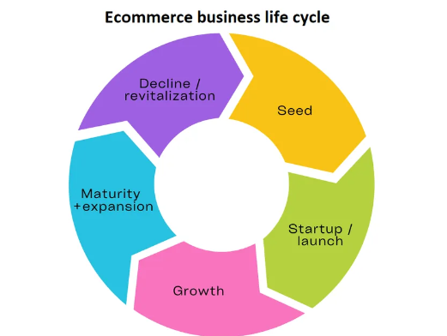

Slide 6
Technology Aspects in E-commerce
E-commerce relies on various technological components to facilitate online transactions and enhance user experience:
1. Online Store: The foundation of e-commerce, where products/services are showcased and transactions occur.
2. Shopping Cart: Enables users to add items for purchase, review selections, and proceed to checkout.
3. Payment Processing: Integrates secure payment gateways for seamless transactions, ensuring confidentiality and integrity.
4. Shipping Management: Automates shipping processes, including order tracking, carrier selection, and delivery management.

Slide 7
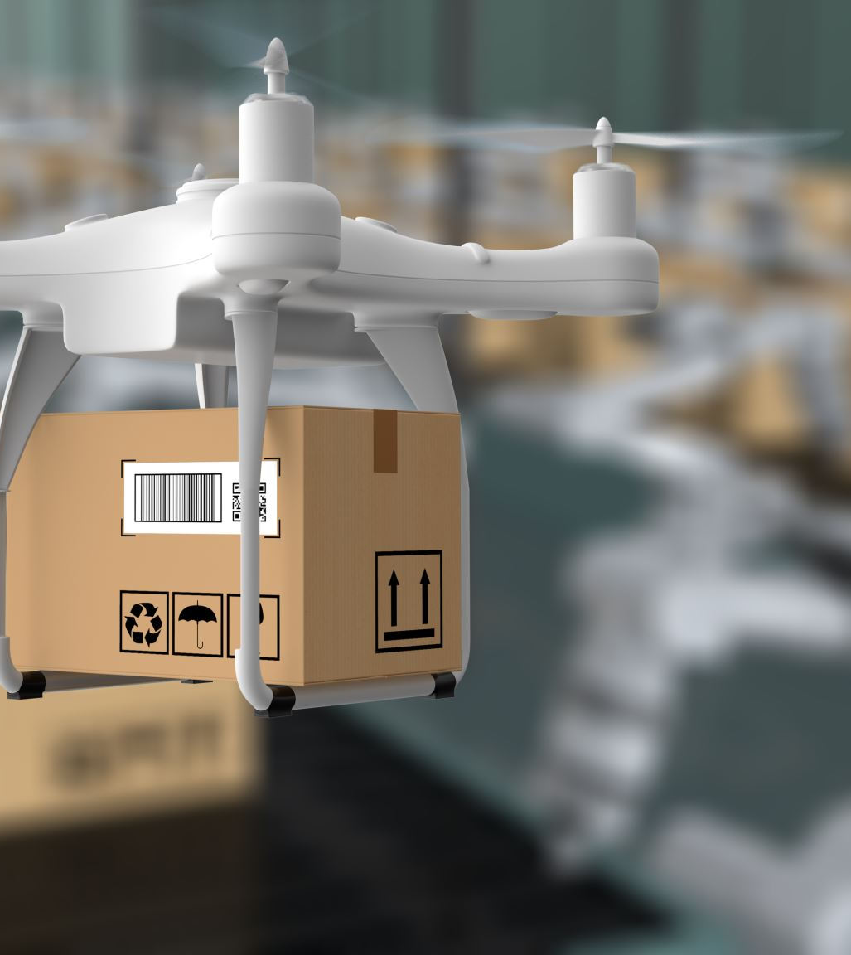
5. Order Fulfillment: Streamlines order processing, inventory management, and fulfillment logistics to ensure timely delivery .
6. E-commerce Technology Trends: Continuously evolving technologies such as AI, chatbots, and voice assistants enhance customer engagement and personalization .
7. Mobile Commerce (m-commerce): Utilizes mobile devices for browsing, purchasing, and payment, catering to the growing trend of mobile usage.
These technological aspects form the backbone of e-commerce platforms, enabling businesses to reach a wider audience, streamline operations, and provide a seamless shopping experience for customers.

Slide 8
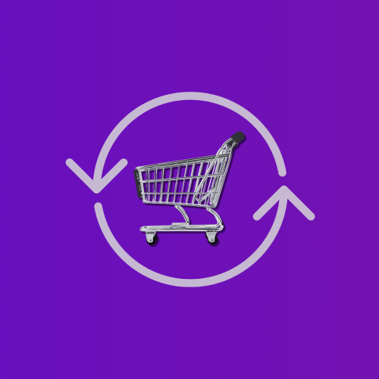
BUSINESS AND CONSUMERS
E-commerce presents significant opportunities and prospects for businesses and consumers:
Market Expansion: E-commerce allows businesses to reach a wider audience beyond geographical boundaries, tapping into new markets and customer segments.
Cost Efficiency: Online platforms reduce operational costs associated with traditional retail, including rent, utilities, and staff, thereby enhancing profitability.
Convenience: For consumers, e-commerce offers convenience through 24/7 accessibility, allowing them to shop at their convenience without time or location constraints.

Slide 9

Personalization: E-commerce platforms leverage data analytics to personalize the shopping experience, offering tailored product recommendations and promotions based on user preferences.
Scalability: Online businesses can easily scale their operations to accommodate growth without significant infrastructure investments, enabling agile adaptation to market demands.
Innovation: The evolution of e-commerce technologies continues to drive innovation, such as AI-powered chatbots, AR/VR experiences, and voice commerce, enhancing engagement and customer satisfaction.
The prospects of e-commerce are promising, offering avenues for business expansion, cost optimization, enhanced customer experience, and technological advancement.

Slide 10

Relationship between buyer and seller in e-commerce
Communication and Interaction: Effective communication lays the foundation for a positive buyer-seller relationship in e-commerce. Sellers need to provide clear product information, answer queries promptly, and offer assistance throughout the buying process. Likewise, buyers should communicate their needs, preferences, and feedback to sellers, fostering transparency and trust.
Trust and Reliability: Trust is paramount in e-commerce transactions. Buyers must have confidence in the seller's credibility, product quality, and reliability in delivering goods or services as described. Establishing trust involves consistent fulfillment of promises, transparent policies, and reliable customer support.

Slide 11

Personalization and Customization: Tailoring offerings to meet individual buyer preferences enhances the buyer's shopping experience and strengthens the relationship. E-commerce platforms leverage data analytics and customer insights to personalize product recommendations, promotional offers, and communication, thereby increasing customer satisfaction and loyalty.
Post-Purchase Engagement: The interaction between buyer and seller doesn't end with the purchase. Post-purchase engagement, such as order tracking, delivery updates, and after-sales support, is crucial for ensuring customer satisfaction and loyalty. Sellers can use automated systems and proactive communication to keep buyers informed and address any issues promptly.

Slide 12

Technology and Innovation: Advancements in technology play a significant role in shaping buyer-seller relationships in e-commerce. Tools such as e-procurement systems, communication channels, and payment gateways streamline transactions, enhance efficiency, and improve overall customer experience.
Feedback and Continuous Improvement: Both buyers and sellers benefit from feedback mechanisms that enable them to understand each other's needs, preferences, and pain points. Soliciting feedback, conducting surveys, and analyzing customer data empower sellers to refine their offerings, address issues, and continuously improve the buyer's experience.

Slide 13

TRADITIONAL COMMERCE AND E COMMERCE
Traditional commerce and e-commerce represent two distinct models of conducting business, each with its own set of characteristics, advantages, and challenges. Understanding the differences between these two approaches is essential for businesses and consumers alike in today's rapidly evolving marketplace. Below, we delve into the disparities between traditional commerce and e-commerce, examining various aspects such as transaction process, market reach, customer interaction, costs, scalability, and security.

Slide 14
Transaction Process
Traditional Commerce
E-commerce
In traditional commerce, transactions typically occur face-to-face in physical brick-and-mortar stores or through other conventional channels like mail order, telephone sales, or direct selling. Customers visit stores, browse products, make purchases, and physically interact with sales representatives or staff.
E-commerce involves conducting business transactions electronically over the internet. Customers access digital storefronts via websites or mobile applications, browse product catalogs, select items, add them to a virtual shopping cart, and complete transactions using online payment gateways. The entire buying process occurs virtually, without the need for physical presence.

Slide 15
Market Reach
Traditional Commerce
E-commerce
Traditional commerce often has limitations regarding market reach due to geographical constraints. Businesses primarily cater to local or regional markets, relying on physical storefronts or distribution channels to reach customers. Expansion into new markets typically involves establishing additional physical locations, which can be costly and time-consuming.
E-commerce transcends geographical boundaries, enabling businesses to reach a global audience with relative ease. Online storefronts have the potential to attract customers from anywhere in the world, provided there is internet connectivity. This expansive reach allows businesses to tap into new markets and customer segments without the need for physical expansion.

Slide 16
Customer Interaction
Traditional Commerce
E-commerce
In traditional commerce, customer interaction tends to be more personal and direct. Customers engage with sales representatives or staff members who provide assistance, answer questions, and guide them through the purchasing process. Face-to-face interaction fosters relationships and allows for immediate resolution of inquiries or concerns.
E-commerce relies on digital interfaces for customer interaction, which can be less personal compared to traditional commerce. Customers navigate websites or mobile apps independently, with limited direct interaction with sales personnel. However, e-commerce platforms often incorporate features such as live chat, chatbots, and customer support channels to facilitate communication and address customer queries remotely.

Slide 17
Costs
Traditional Commerce
E-commerce
Traditional commerce involves various overhead costs associated with maintaining physical storefronts, inventory management, staffing, utilities, and other operational expenses. These costs can be substantial, particularly for businesses operating in prime retail locations or facing high rental rates.
E-commerce generally entails lower overhead costs compared to traditional commerce. While there are expenses related to website development, hosting, maintenance, and digital marketing, they are often less significant than the costs associated with maintaining physical stores. E-commerce businesses can also benefit from economies of scale and automation, leading to cost efficiencies in various aspects of operations.

Slide 18
Customer Interaction
Traditional commerce offers face-to-face interaction, allowing customers to physically examine products before purchase.
E-commerce relies on digital interfaces, offering virtual product views and online customer support

Slide 19
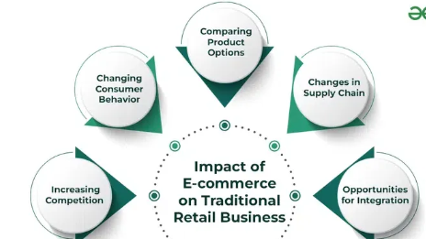

Slide 20

Innovative E-commerce Websites

Slide 21

Amazon: A global giant offering a vast range of products and services, dominating the e-commerce market.
Flipkart: A major player in India's e-commerce landscape, providing diverse products and services .
Nykaa: Known for its extensive range of beauty and wellness products, Nykaa is a prominent e-commerce platform in India.
IndiaMART: A leading online marketplace connecting buyers with suppliers, particularly focused on B2B transactions .
Meesho: An Indian e-commerce platform specializing in social commerce, enabling individuals to start their own businesses.

Slide 22

FirstCry: Catering to the needs of parents and children, FirstCry offers a wide array of baby and kids' products.
BookMyShow: Primarily focused on ticketing for movies, events, and other entertainment activities, BookMyShow is a popular e-commerce destination in India.
eWorldTrade: A rising star in global trade, eWorldTrade provides a platform for businesses to engage in international commerce.
Home: Offering a diverse range of products for home improvement and decor, Home is a notable e-commerce website in the US .
Walmart: A well-established retailer, Walmart's e-commerce platform provides a wide selection of products along with convenience and competitive pricing.

Slide 23
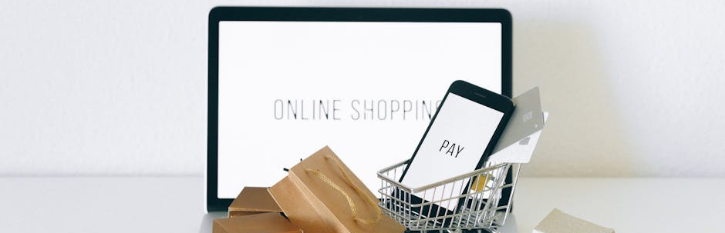
Trends in E-commerce
Here are some key features for trends in today's world -

Slide 24
Omnichannel Experiences: Integration of online and offline channels to provide seamless shopping experiences.
Artificial Intelligence (AI): Utilization of AI for personalized recommendations, chatbots, and predictive analytics to enhance customer experience.
Social Commerce: Evolution of social media platforms as shopping destinations, enabling direct purchasing within social networks.
Sustainability: Emphasis on eco-friendly practices, including sustainable sourcing, packaging, and carbon-neutral shipping options .
Fast and Free Delivery: Increasing demand for expedited shipping options and free delivery services to meet customer expectations.

Slide 25

User Experience
Personalization
Tailoring shopping experiences based on individual preferences.
Visual Search
Integration of image recognition for product search.
Seamless Navigation
Effortless browsing and intuitive UI for better user engagement.
Photos provided by Pexels

Slide 26
Technology Integration
Blockchain
Artificial Intelligence
Augmented Reality
Secure and transparent transactions using blockchain technology.
AI-driven chatbots, product recommendations, and customer service.
AR for virtual try-on and visualization of products.

Slide 27

Personalization and AI
Predictive Analytics
Utilizing data to forecast customer behavior and preferences.
Dynamic Pricing
Real-time pricing adjustments based on market demand and consumer behavior.
Chatbot Assistance
AI-powered virtual assistants for personalized customer support.

Slide 28

Mobile Commerce
Mobile Optimization
In-App Purchases
Responsive design and mobile-friendly interfaces for seamless mobile shopping.
Convenient in-app buying experiences for mobile users.
Mobile Wallets
Integration of digital wallet options for secure mobile payments.

Slide 29

Future of E-commerce
Voice Commerce
Rise of voice-enabled shopping experiences through virtual assistants.
Social Commerce
Integration of social media platforms for direct purchasing.
Subscription Services
Increased adoption of subscription-based e-commerce models.

Slide 30
Thankyou

